Slide 1
Spectrogram EEG patterns
Ji Yeoun Yoo, MD
Associate Professor of Neurology

Slide 3
Rhythmicity spectrogram (L and R)
Rhythmicity from 1 to 25 Hz (Y-axis) is displayed by a color scale
X-axis is time
Deep blue (most rhythmic), Pale yellow (not rhythmic)
For very focal events, can be displaced using fewer electrodes as input, for example, by quadrants.

Slide 4
Fast Fourier series Transform (FFT) spectrogram (L and R)
EEG signal is broken up into component frequencies, 0-20 Hz on the Y-axis
X-axis is time
The abundance and amplitude of raw EEG at a given frequency are represented by a color power spectrogram
Blue (very little) to White (maximal)
For very focal events, can be displaced using fewer electrodes as input, for example, by quadrants.

Slide 5
Asymmetry Index/spectrogram
Comparison of the power of the EEG in homologous right and left electrodes at each frequency
Red when the right has increased power compared to the left
Blue when the left has increased power compared to the right

Slide 6
Amplitude EEG (aEEG)
EEG signal amplitude (from peak to peak)
Right hemisphere (Red)
Left hemisphere (Blue)
Symmetric (Pink)

Slide 7
Alpha-Delta Ratio
The higher the ratio, the faster the EEG
Decreasing ADR can be a marker of vasospasm and impending cerebral ischemia
When CBF decreases, the first change is loss of faster frequencies, followed by increase in slower frequencies -> both cases, the ADR decreases.

Slide 8
Suppression Index
Displays the percentage of EEG that is suppressed
The higher the level of suppression, the higher the line of the trend

Slide 9
Vs. Baseline control spectrogram
Takes the patient’s own baseline EEG and demonstrates changes from that baseline
The power in each frequency is compared to the empiric null using the number of standard deviations (z-score) represented by color (green to blue: negative z-score, green to red: positive z-score)

Slide 10
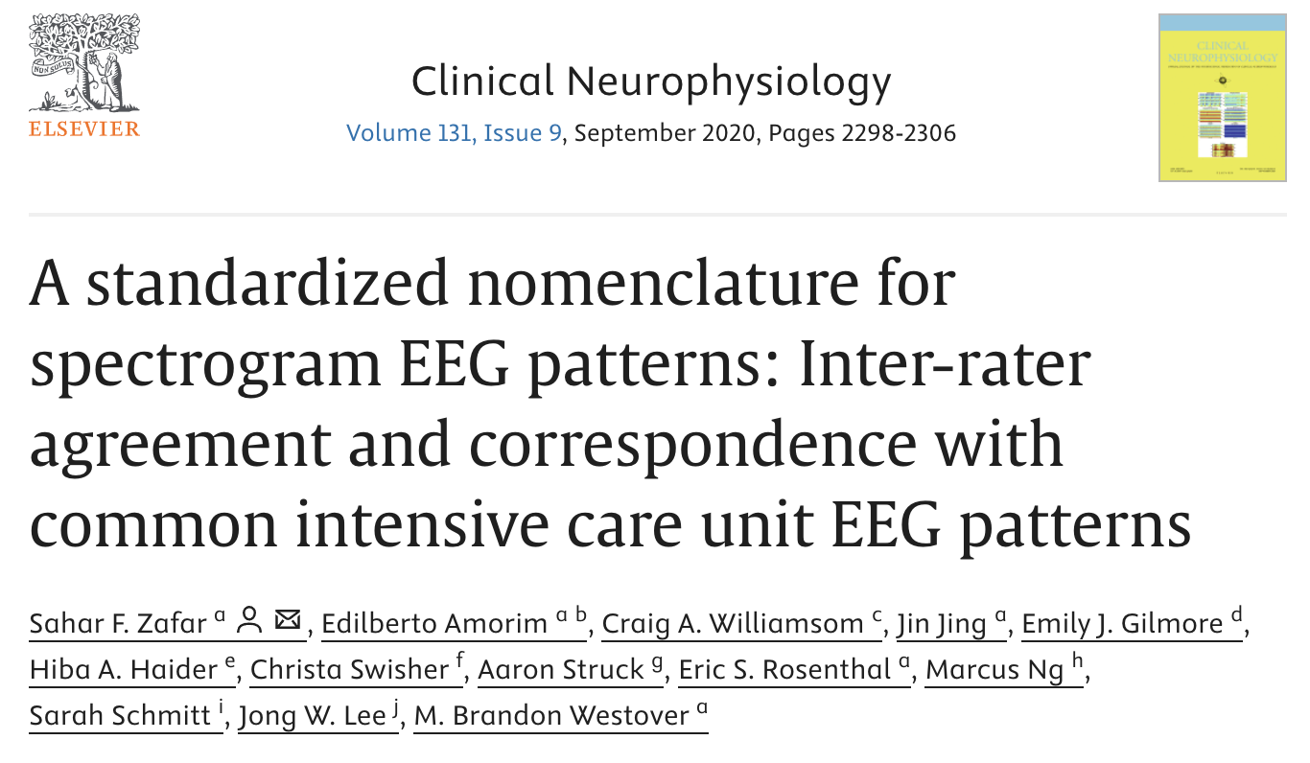

Slide 11
“Solid flames”: This pattern is characterized by an abrupt appearance of spectrogram segments with high-power and bandwidth, rising “up” from the delta range into theta and often into the alpha frequency range, similar in appearance to candle flames. Solid flames have smooth edges. When they recur, they are stereotyped and each instance appears similar to the others.
“Irregular flames”: These events have a flame-like shape, but are characterized by edge “choppiness” or “irregularity”. They tend not to be stereotyped.
“Broadband-monotonous”: Spectrograms with this pattern are characterized by minimal variation over time or gradual waxing and waning of sustained high power (yellow/red/white) extending across a broad band of frequencies, extending up to high (>5 Hz) frequencies.
“Narrowband-monotonous”: Spectrograms with this pattern have a sustained band of high-power (yellow/red/white) restricted to low (<5 Hz) frequencies. There is minimal variation within the high-power band.
“Stripes”: This pattern is essentially synonymous with burst suppression, and is characterized by alternation between diffuse low power (suppression), and high power “stripes” (bursts). In other words, sequential events with high power across a range of frequencies (bursts) give the spectrogram a striped appearance.
“Low power”: These spectrograms are characterized by diffuse low power, and appear monotonous. There is often a narrow band of dark blue/cyan/green (low power), which should be distinguished from the higher power yellow/red band seen in narrowband-monotonous.
“Artifact”: This pattern is characterized by irregular high-power signal saturating the spectrogram colormap across a broad range of frequencies.

Slide 12
Solid Flames represented seizures or IIC patterns 69.4% of the time.
Irregular Flames represented seizures or IIC patterns 38.7% of the time.
Broadband-monotonous primarily corresponded with seizures or IIC (54.3%)
Narrowband-monotonous with focal or generalized slowing (43.8%).
Stripes were associated with burst-suppression (37.2%) and generalized suppression (34.4%).
Low Power category was associated with generalized suppression (94%).
There was “near perfect” agreement for Solid Flames (κ = 94.36), Low power (κ = 92.61), and Artifact (κ = 93.72). There was “substantial agreement” for all other categories (κ = 74.65–79.49).

Slide 13
Solid Flames

Slide 14
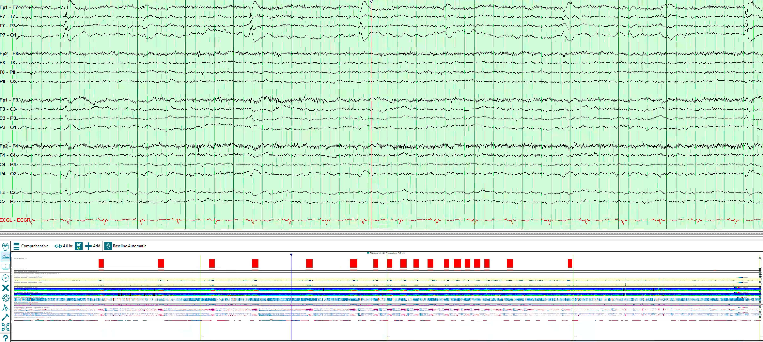

Slide 15
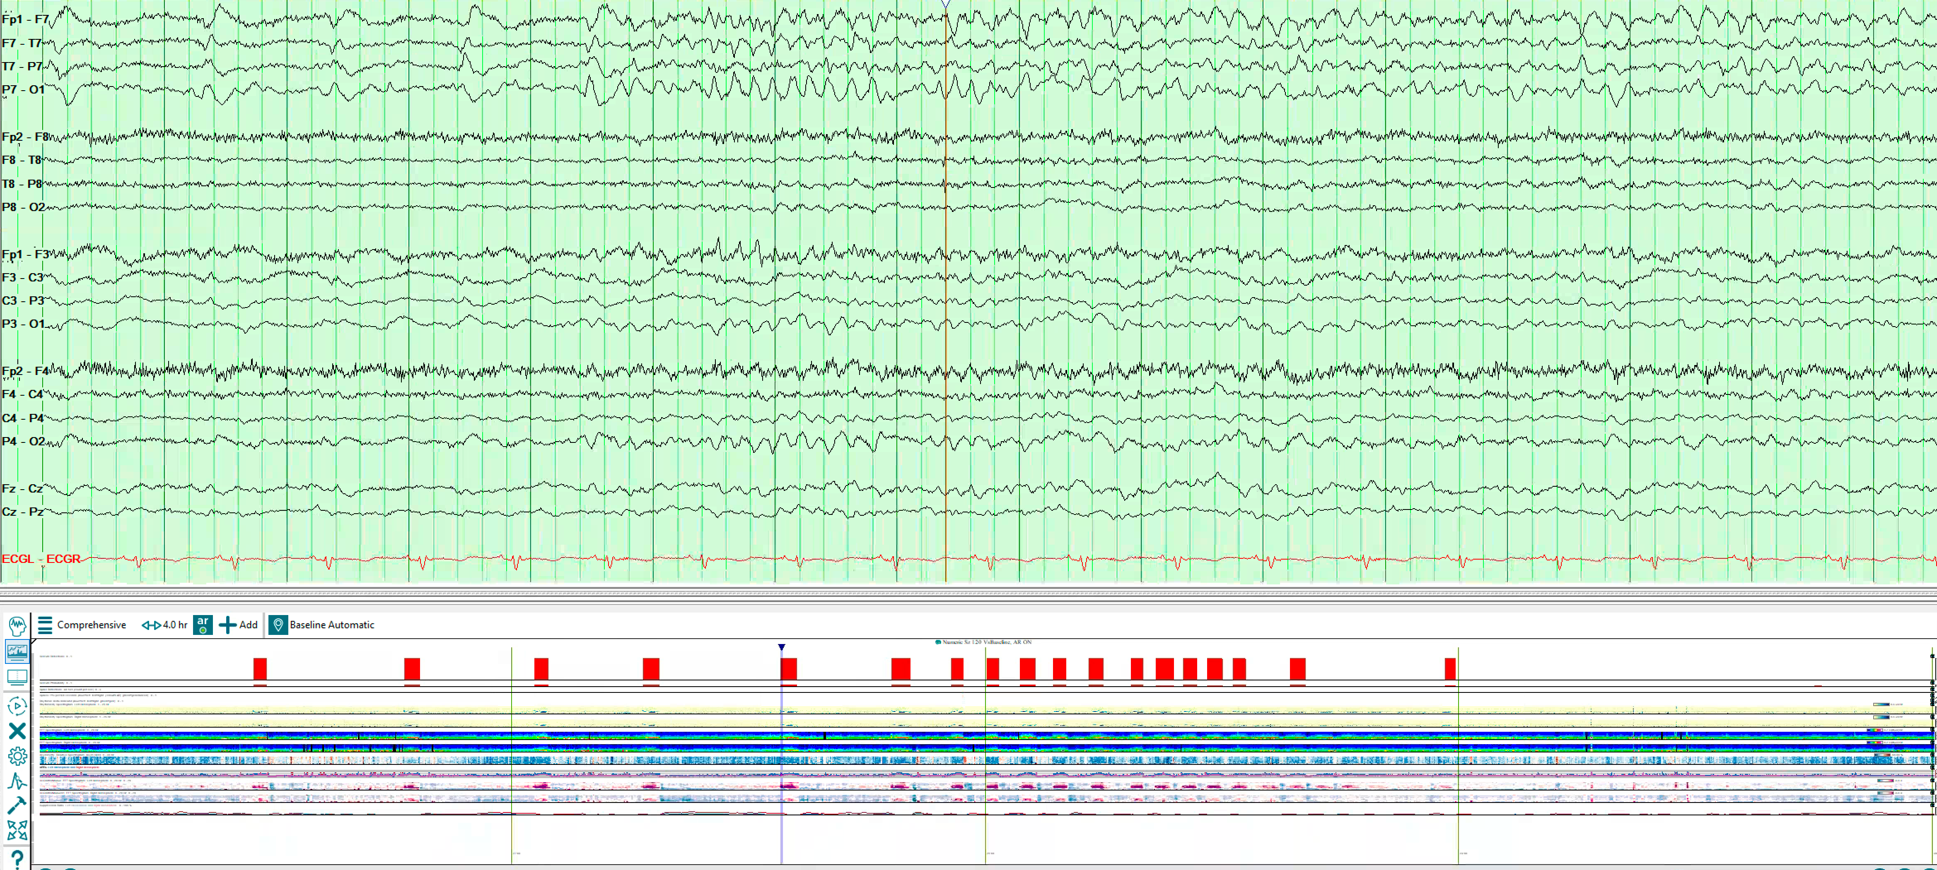

Slide 16
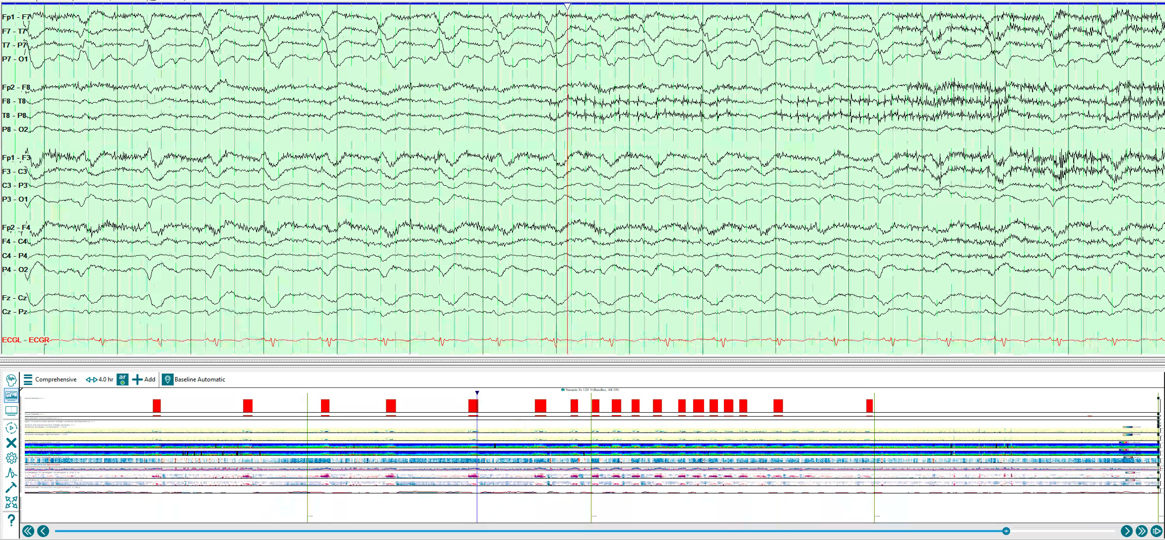

Slide 17
Irregular Flames

Slide 18
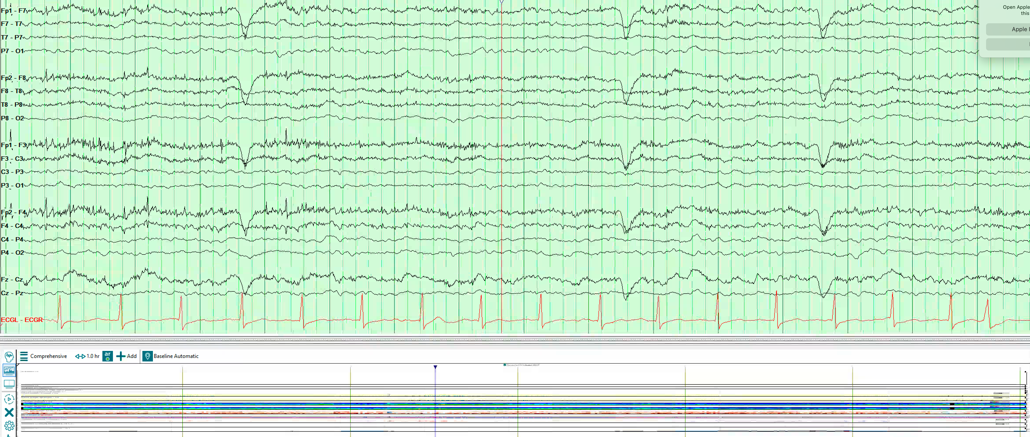

Slide 19
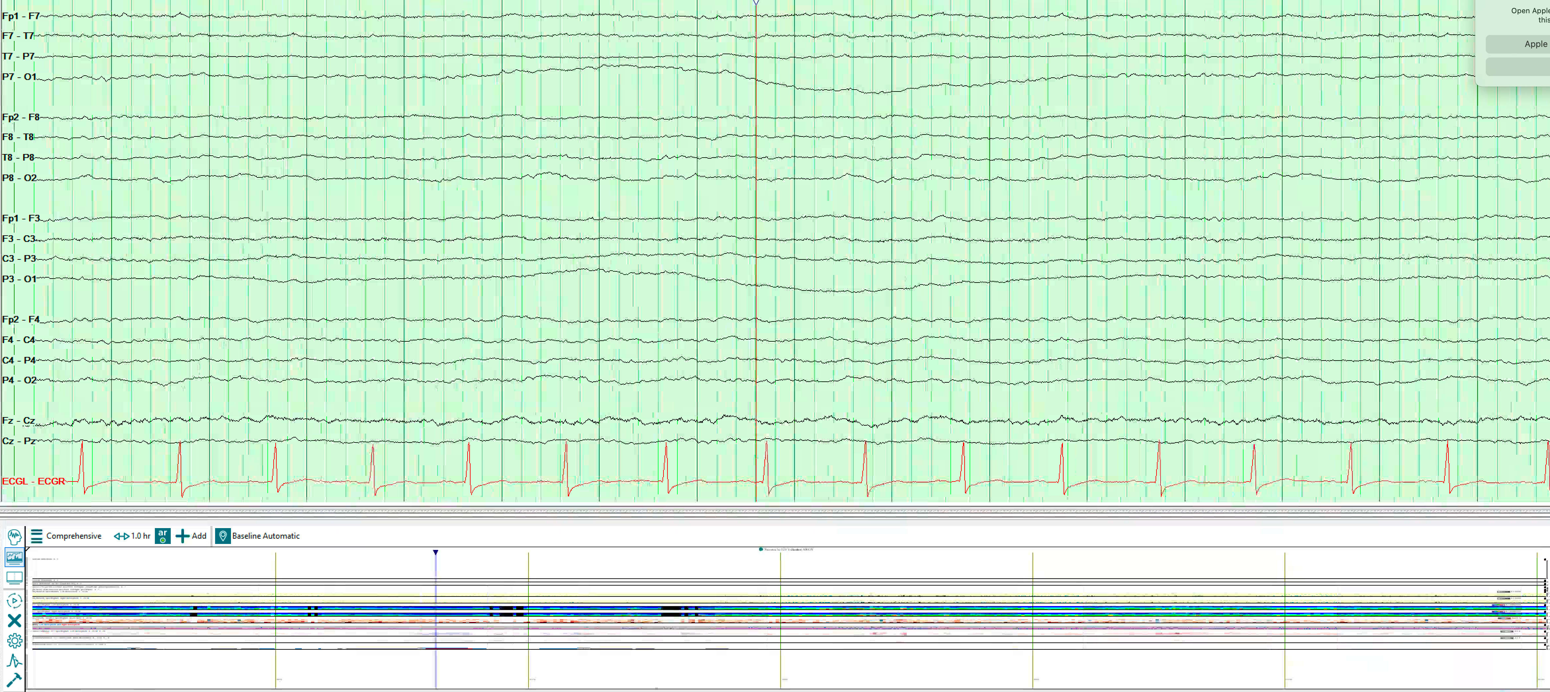

Slide 20
Broadband-monotonous

Slide 21
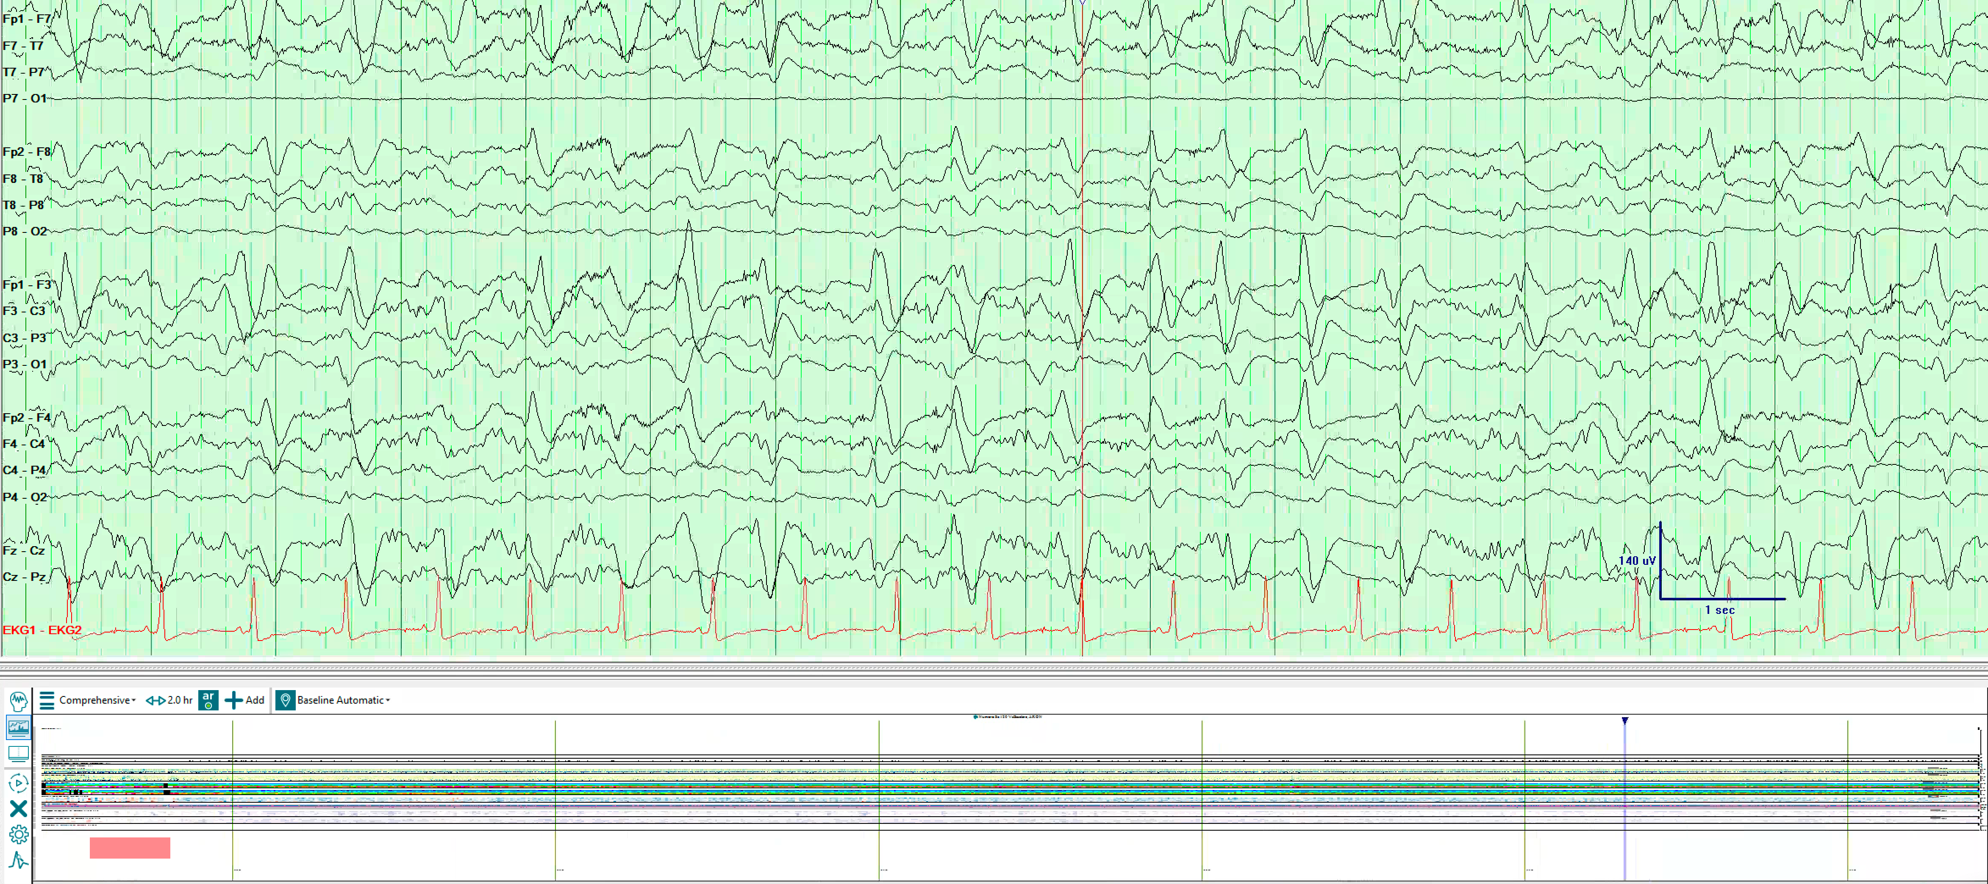

Slide 22
Narrowband-monotonous

Slide 23
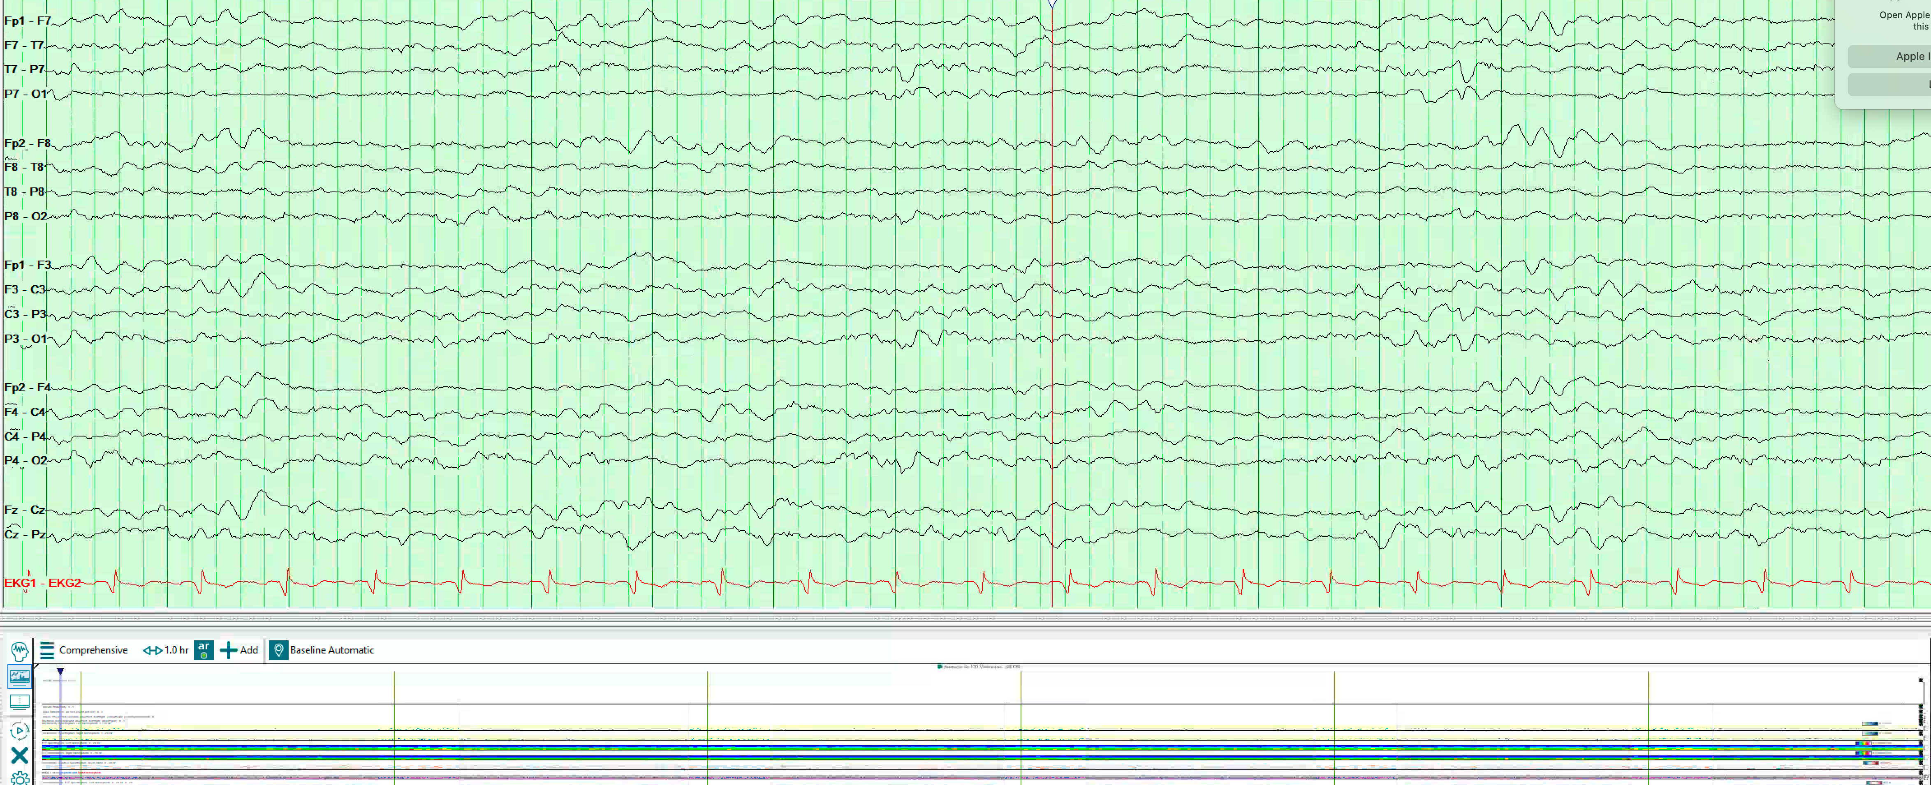

Slide 24
Low-power

Slide 25
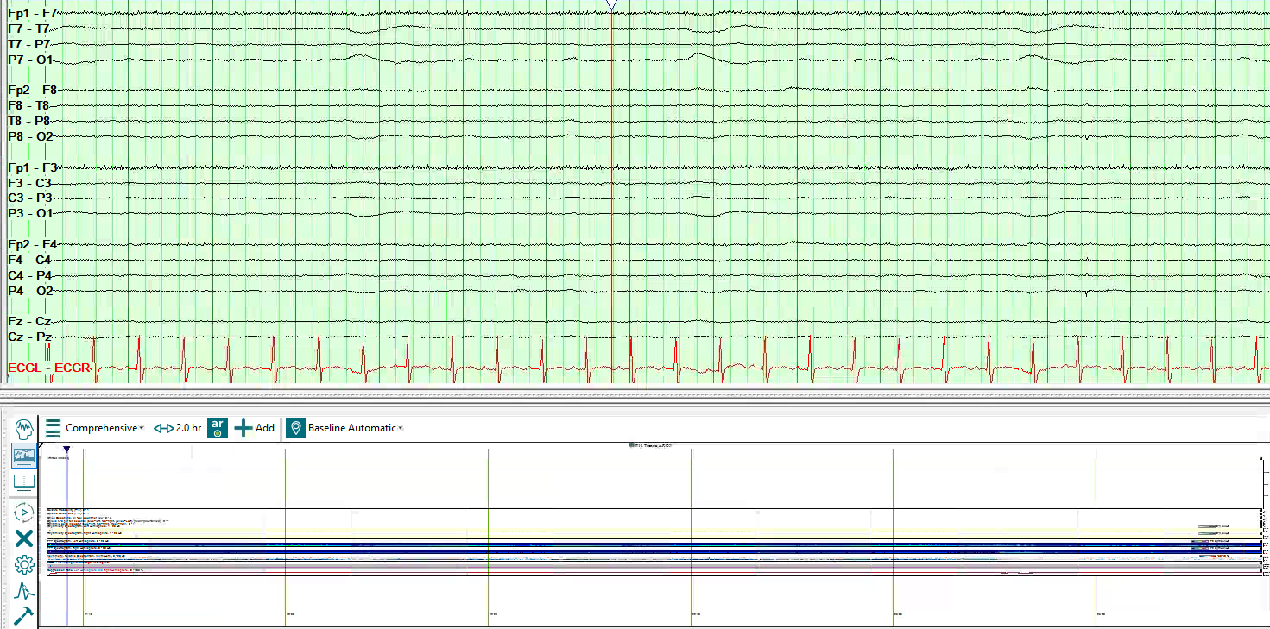

Slide 26
Stripes

Slide 27
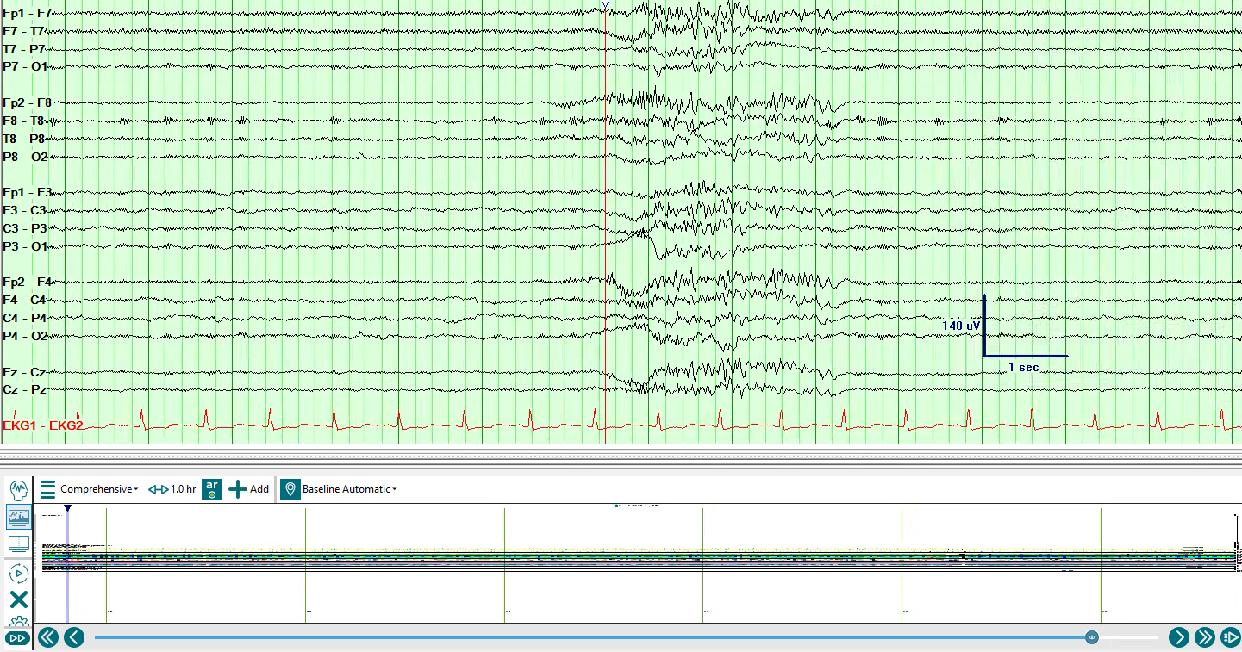

Slide 28
Questions

Slide 30
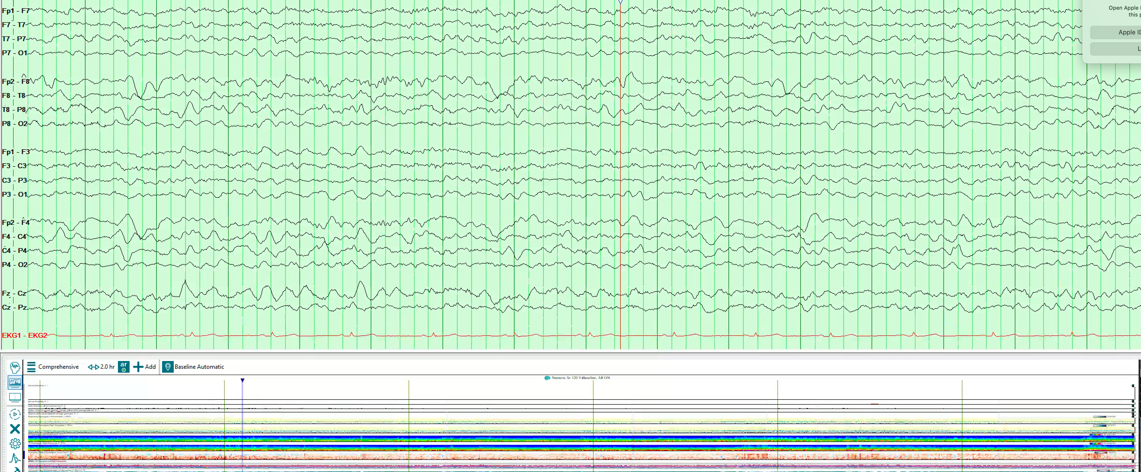

Slide 31
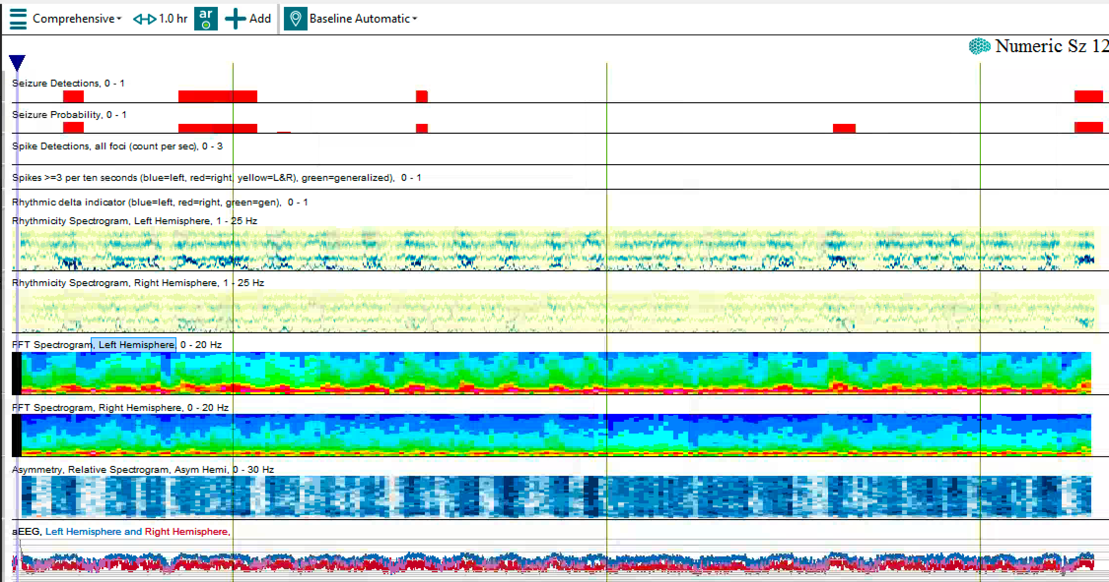
Routine EEG (30 min recording)

Slide 32
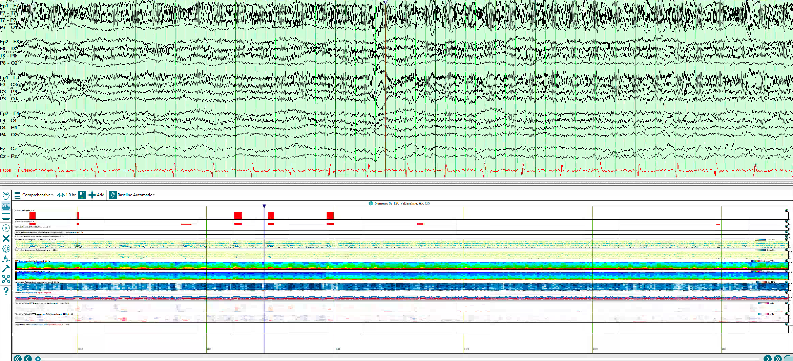

Slide 33
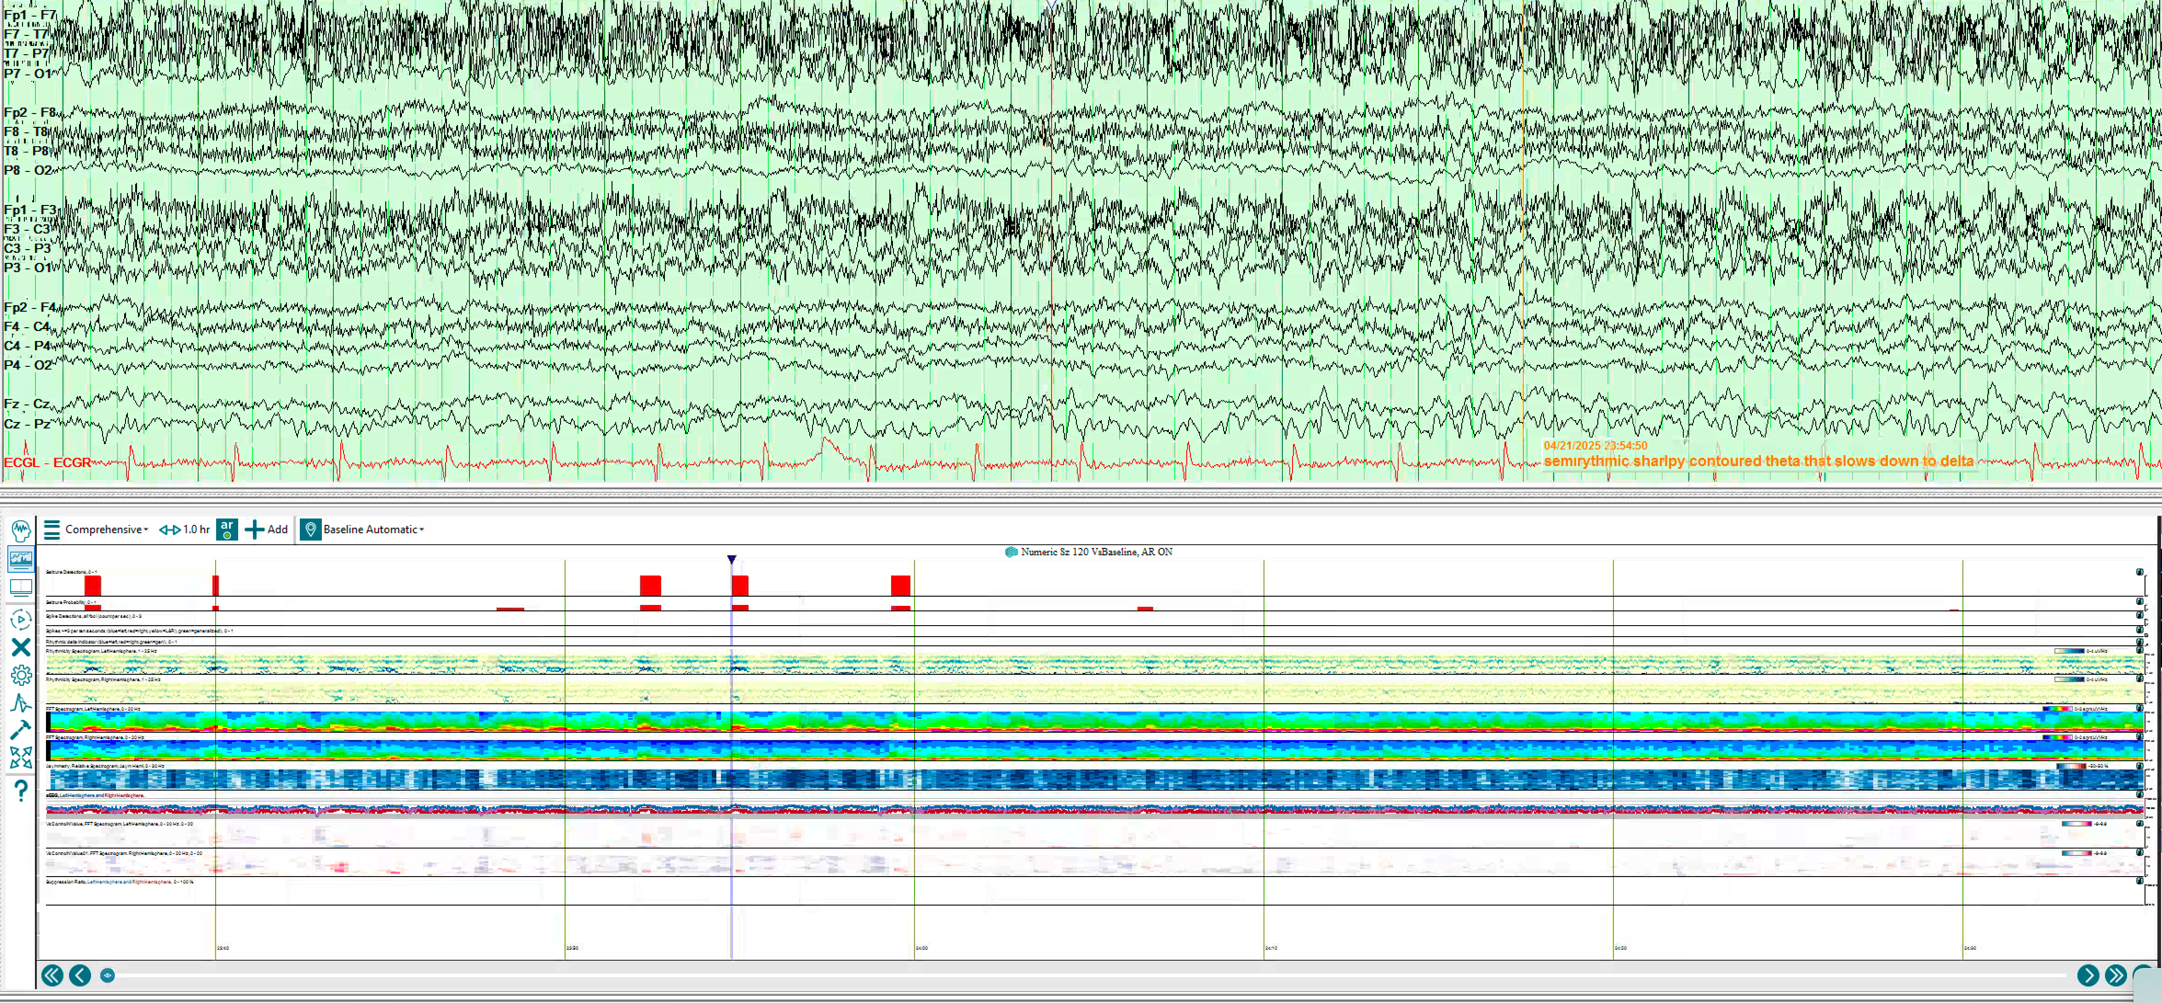

Slide 34
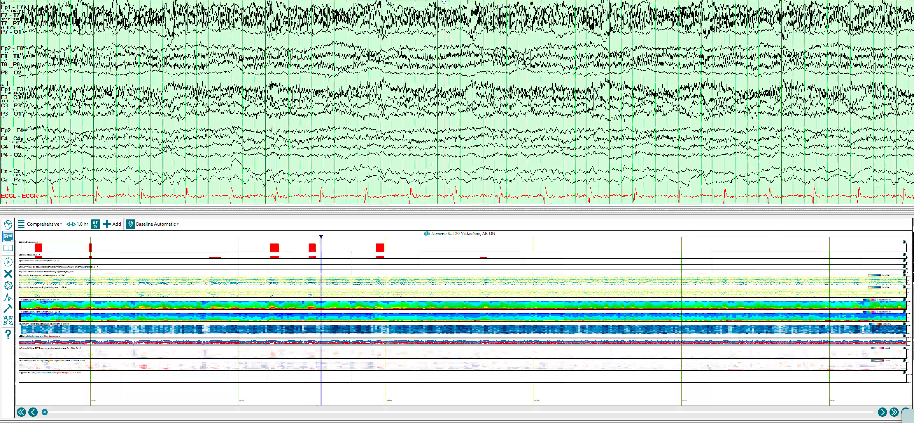

Slide 35
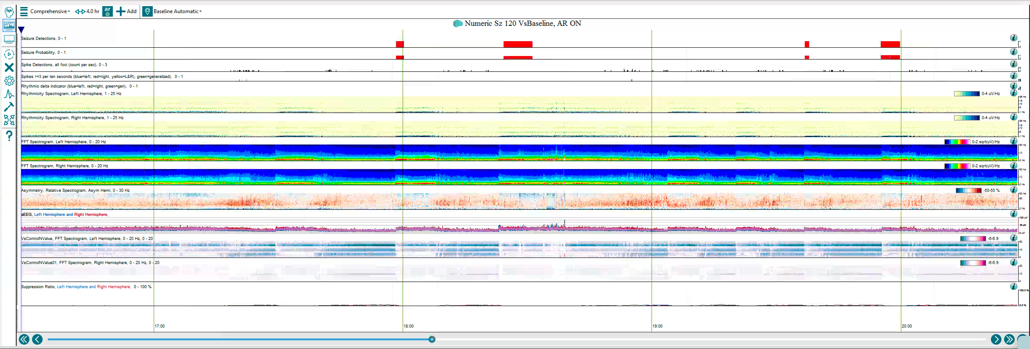

Slide 36
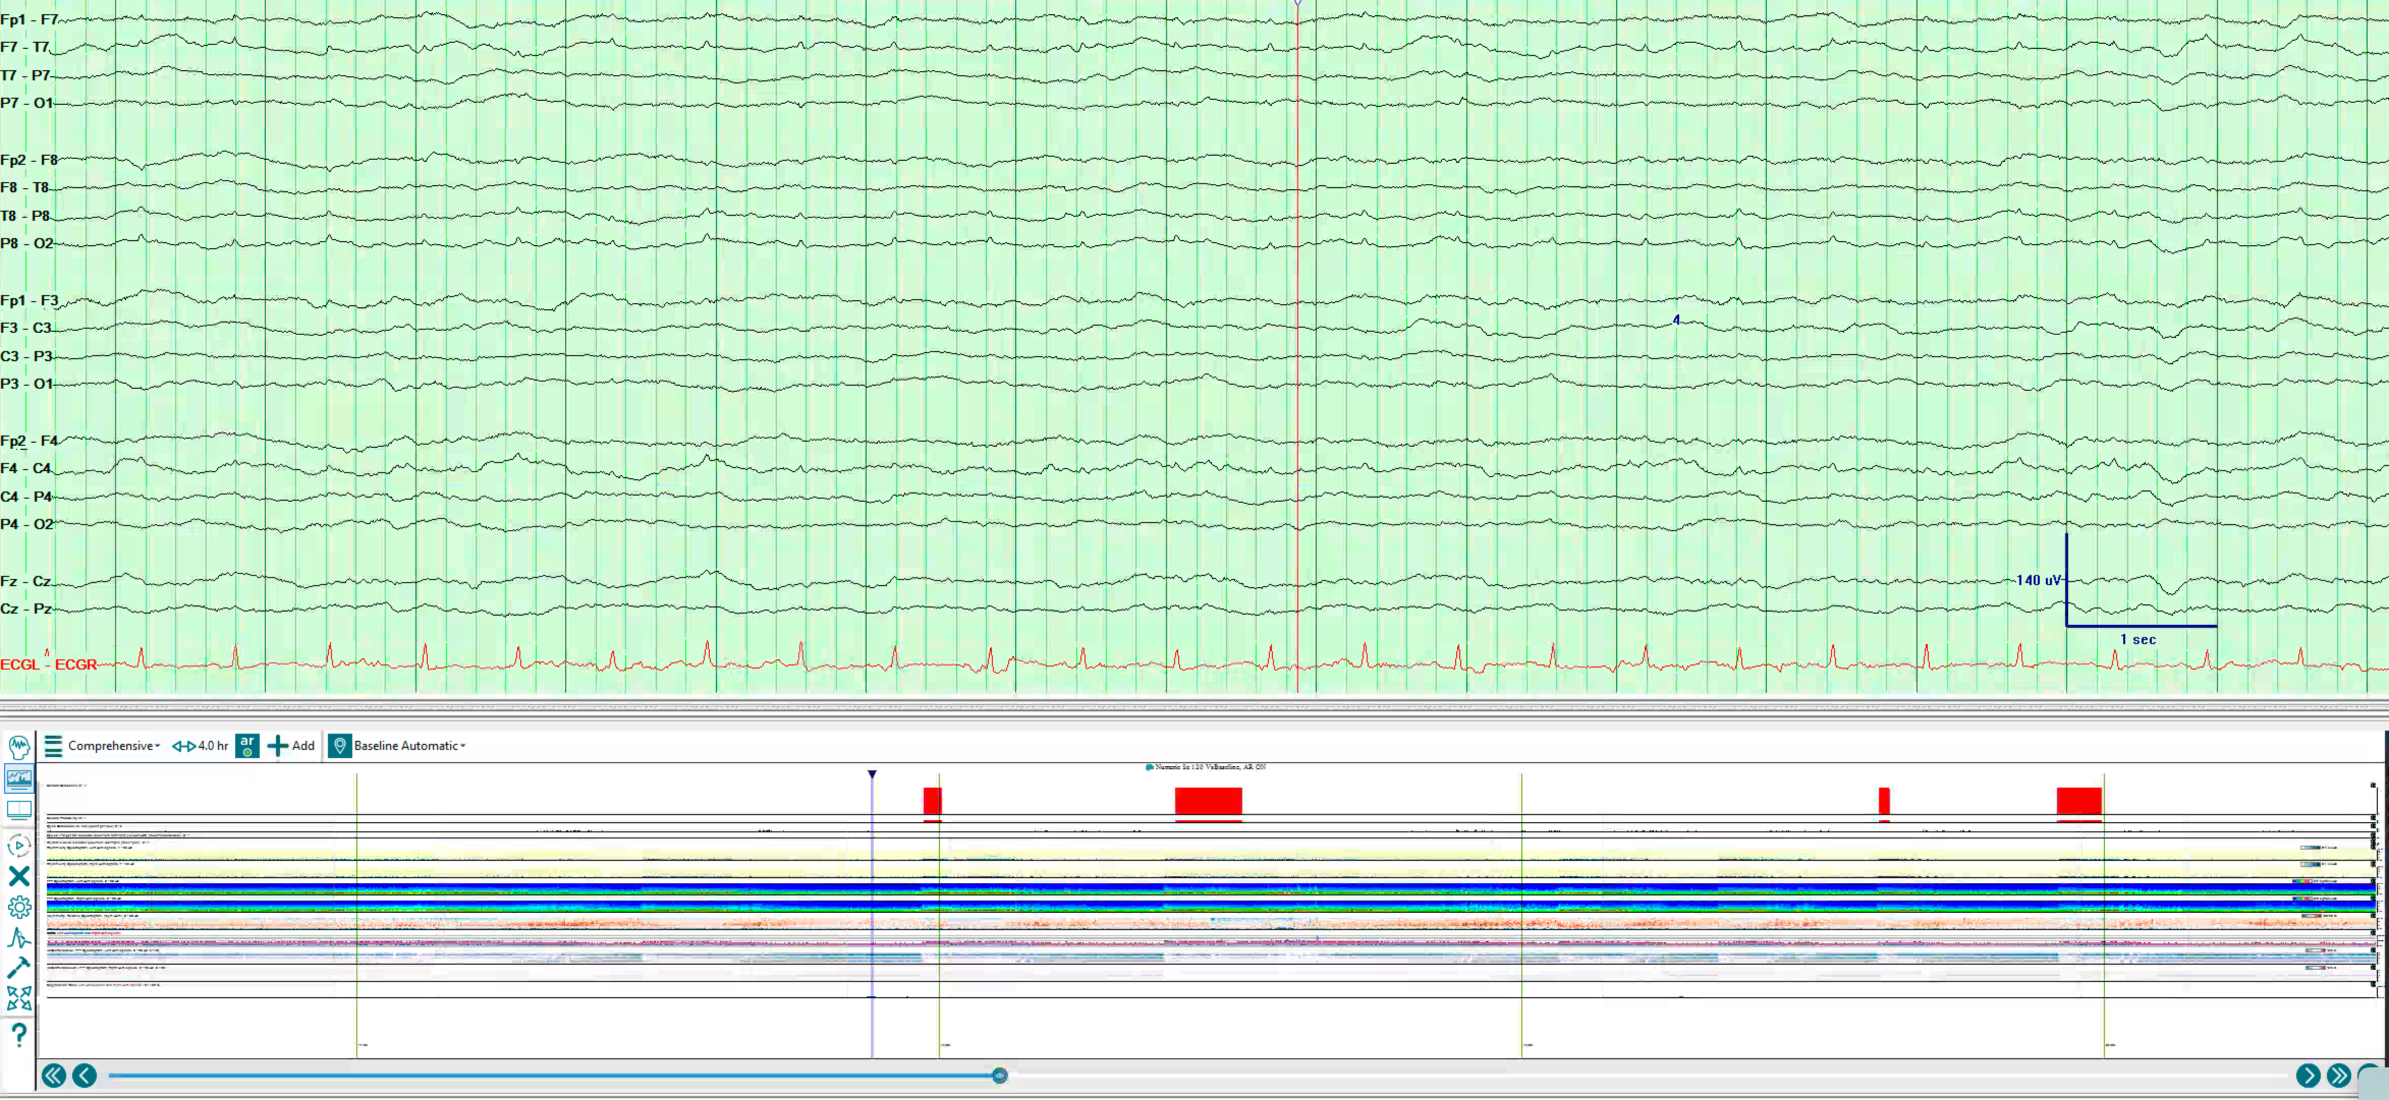

Slide 37
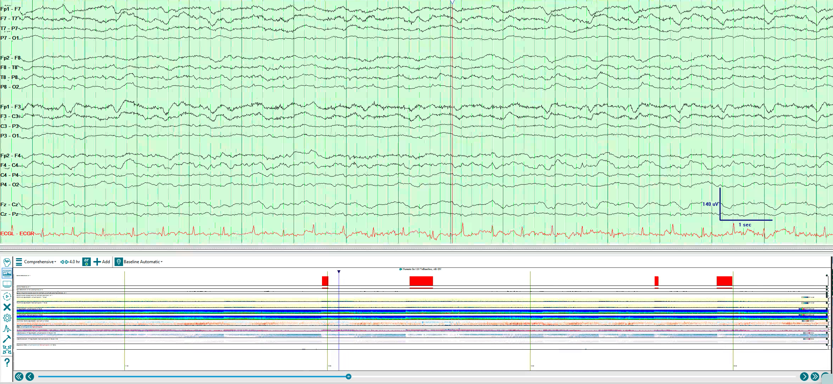
Notes:
CAPE with SIRPIDs (L frontal LPDs)

